Slide 1


Inventory Module

Slide 2
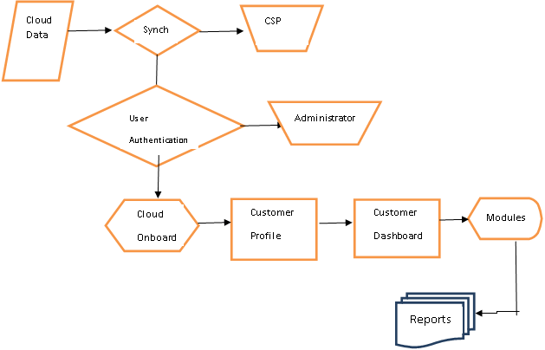
Flow Chart

Slide 3
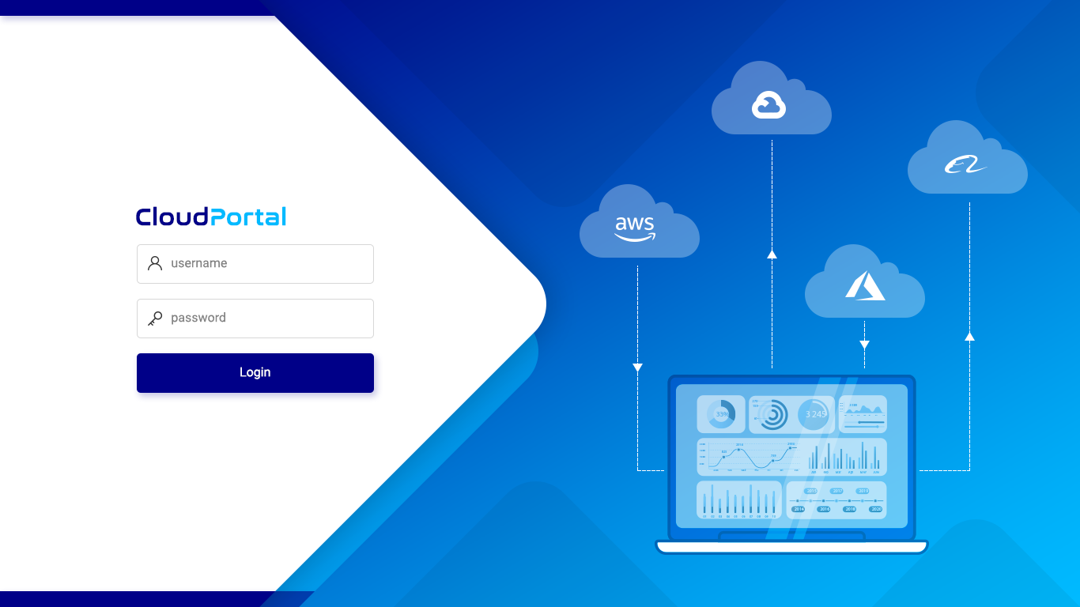
Notes:
LOGIN PAGE:
On click Login page will redirect to Inventory Dashboard

Slide 4
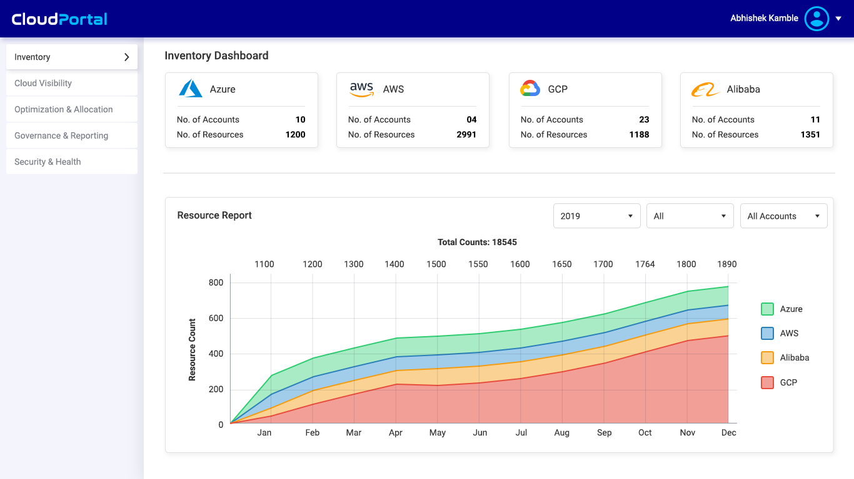
Notes:
INVENTORY DASHBOARD:
On click AWS box page will redirect to AWS Resources list page
By default overall Total Counts will be displayed in the graph of Azure, AWS, Alibaba and GCP

Slide 5
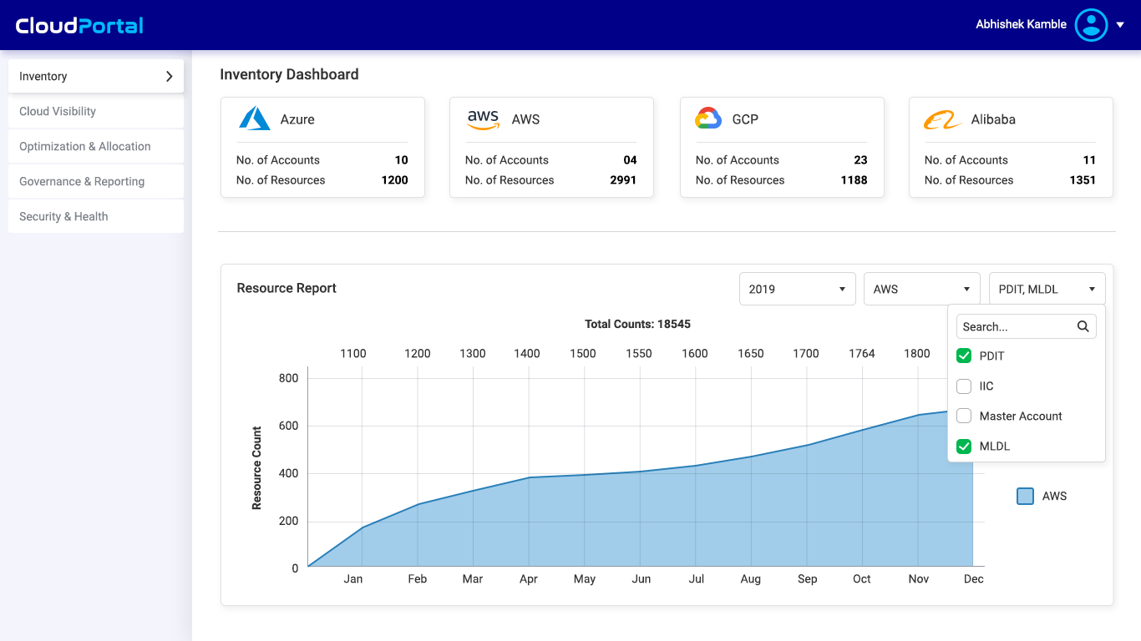
Notes:
INVENTORY DASHBOARD:
On click AWS box page will redirect to AWS Resources list page
In the graph if AWS is selected then all AWS accounts list will be visible

Slide 6
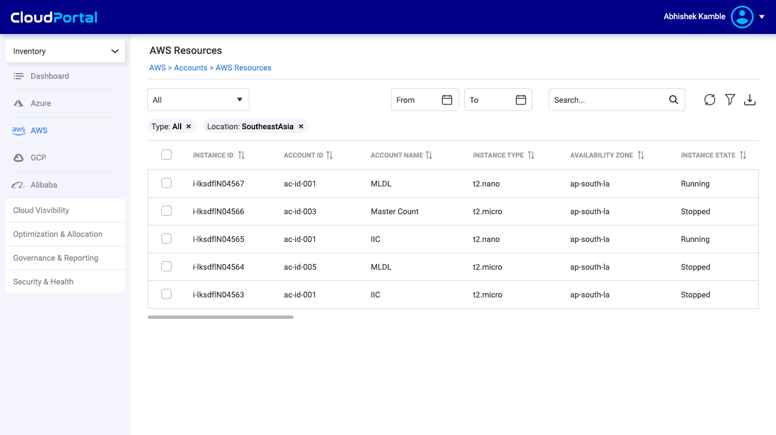
Notes:
AWS RESOURCES:
By default all accounts list will be visible (along with account ID and account name in the list)

Slide 7
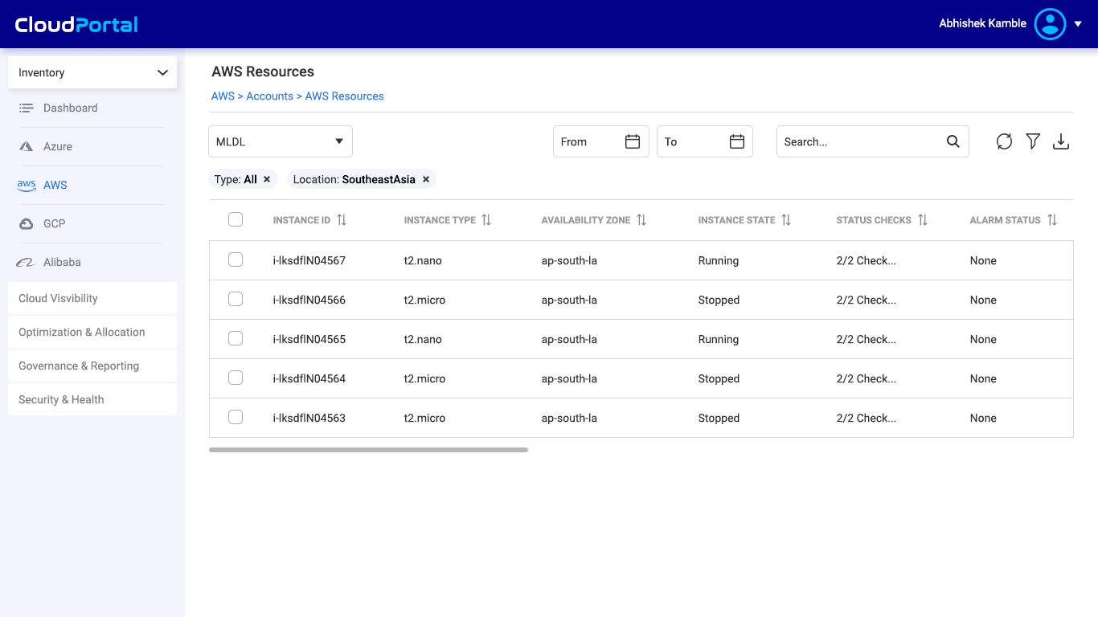
Notes:
AWS RESOURCES:
For viewing a particular account list for example MLDL the below list view will appear

Slide 8
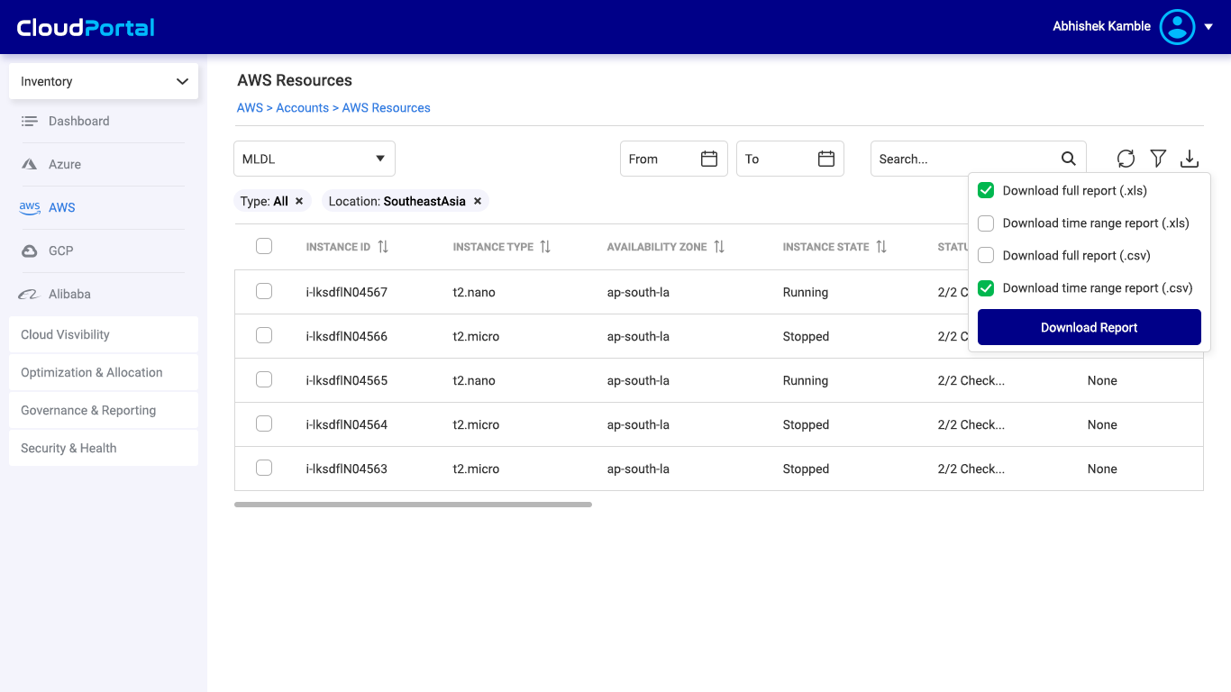
Notes:
AWS RESOURCES:
On click download icon, download options will appear as seen in the screens

Slide 9
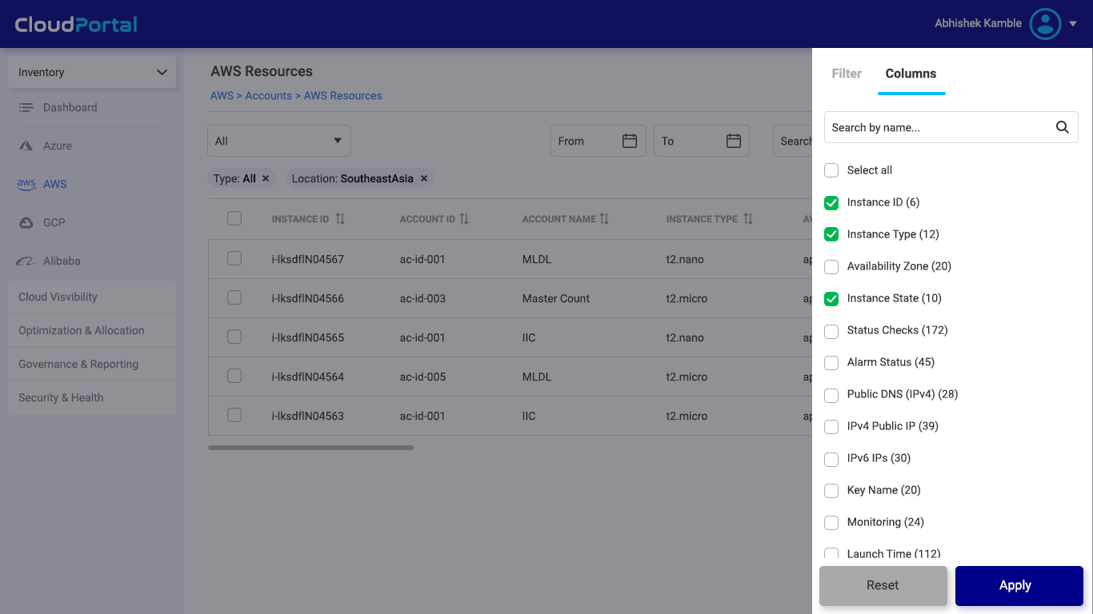
Notes:
AWS RESOURCES FILTER WINDOW:
On click filter icon, side popup window will appear for custom column and filter settings
From here columns can be customized (add and remove columns)

Slide 10
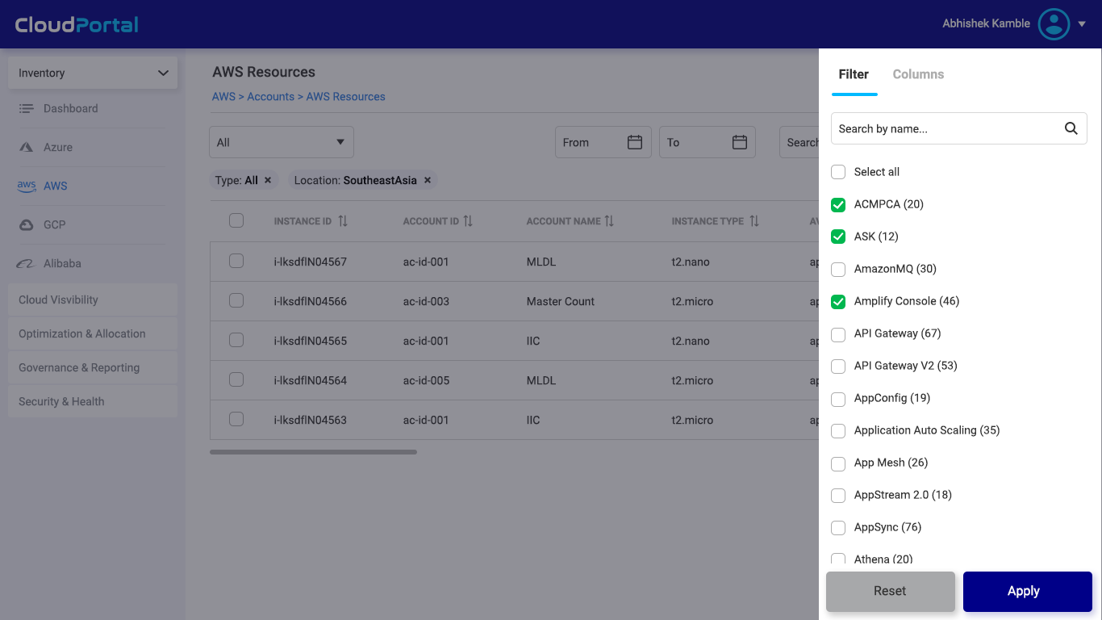
Notes:
AWS RESOURCES FILTER WINDOW:
From here each columns values can be customized (add and remove)

Slide 11

Animated Logo.
It will play when on presentation mode.
Please delete this comment.

